Slide 1
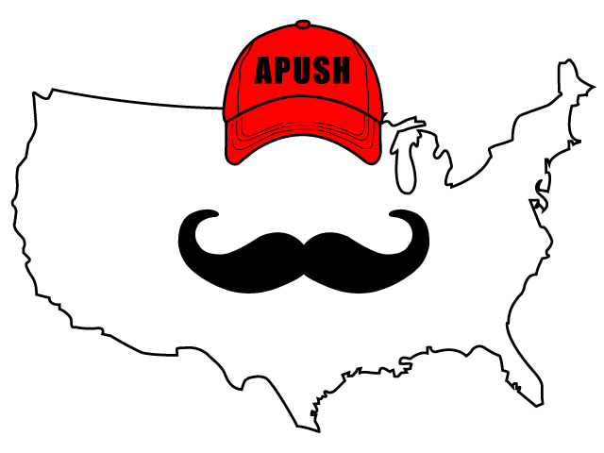
APUSH Review: Video #52: The Korean War (Key Concept 8.1, I, B)
Everything You Need To Know About The Korean War To Succeed In APUSH
www.APUSHReview.com

Slide 2
Events Prior To The Korean War
Korea was divided at the 38th parallel
Divided at the Potsdam Conference
North = Communist, led by Kim Il-Sung
South = Non-Communist, led by Sygman Rhee
Executive Order 9981 (1948)
Desegregated the military
1949 - “Fall of China” - Truman was blamed
Cold War was in full effect - Containment

Slide 3
Fighting During The War
June, 1950 - North Korea invaded South Korea
Took over almost all of the peninsula
Truman saw the invasion as an act by the Soviet Union
The US drastically increased its military size and spending
NSC-68

Slide 4
Fighting During The War
North Korea was pushed back beyond the 38th parallel
China intervened on November 25, on behalf of North Korea
General MacArthur wanted to fight a large scale war and attack the Chinese
MacArthur criticized Truman’s plan
Truman fired MacArthur

Slide 5
End Of The War
July, 1953: President Eisenhower agreed to a division of North Korea at the 38th parallel; demilitarized zone
36,940 Americans were killed
103,284 were wounded
Many POWs
By the end of the war, almost all African Americans fought in integrated units

Slide 6
Impacts Of The War
Tensions increase between the US and China
Defense spending increased drastically
New industries develop – sun belt
Presidential wartime powers increased
Truman intervened without a declaration of war from Congress
US would engage in conflicts to promote containment

Slide 7
Quick Recap
“Fall of China”
38th parallel
Executive Order 9981
NSC-68
End of war = 38th parallel
Increase in defense spending and power of the executive branch

Slide 8
See You Back Here For Video #53: The Second Red Scare & The Military Industrial Complex,
Thanks for watching
Best of luck!

