Slide 1
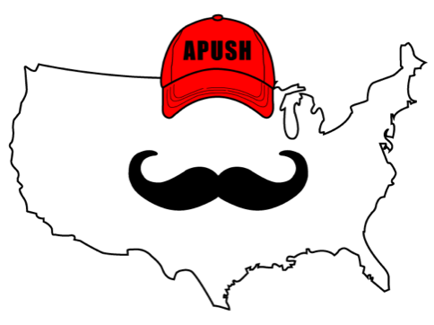
APUSH Review: Video #32: Attempts To Resolve Slavery In The Territories (Key Concept 5.2, II, B)
Everything You Need To Know About Attempts To Resolve Slavery In The Territories To Succeed In APUSH
www.APUSHReview.com

Slide 2
Big Idea
As the US expanded, the number one issue was slavery
Should this new land be free or slave?
Missouri Compromise
Banned slavery NORTH of 3630’ line in LA Purchase Territory
Wilmot Proviso - proposed all land from Mexican Cession would be free
Never became law

Slide 3
Compromise of 1850
Dealt with land gained from Mexican Cession
5 Parts:
Popular Sovereignty in Mexican Cession
Tough Fugitive Slave Law
Abolition of slave trade in D.C.
California was admitted as a free state
Texas paid $ to give up territory

Slide 4
Kansas-Nebraska Act (1854)
Background Info:
The North wanted to build a transcontinental RR that would go through the North
Both Kansas & Nebraska were above the 3630’ line in the LA Territory
The South would NOT support adding 2 free states

Slide 5
Kansas-Nebraska Act (1854)
Stephen Douglas proposed the Kansas-Nebraska Act
Called for popular sovereignty in Kansas & Nebraska
The expectation was that Kansas would be free and Nebraska would be slave
Overturned the MO Compromise of 1820

Slide 6
Kansas-Nebraska Act (1854)
Helped lead to “Bleeding Kansas”
Fighting in Kansas between pro-slavery and anti-slavery groups
John Brown and his followers killed 5 pro-slavery individuals at Potawatomie Creek
Fighting continued on and off until the Civil War

Slide 7
Dred Scott Decision (1857)
Background Info:
Dred Scott, a slave traveled to free territories with his slave owner
After his slave owner’s death, he sued for his freedom

Slide 8
Dred Scott Decision (1857)
The Court’s ruling:
African Americans (free and slave) were NOT citizens and could not sue in court
Slaves were considered property and could not be taken away without “due process” (5th amendment)
The Missouri Compromise was unconstitutional and Congress could not regulate slavery in the territories

Slide 9
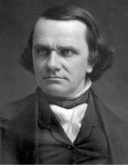
Impact Of Dred Scott Decision (1857)
Tensions increase between North and South
Some sought to not enforce the Supreme Court decision
Split the Democratic Party along sectional (North/South) lines
African Americans will be granted citizenship with the 14th amendment (1868)

Slide 10
Quick Recap
5 parts to the Compromise of 1850
KS-NB Act overturned the MO Compromise
Dred Scott Decision and impacts
All were attempts to address the issue of slavery in the territories

Slide 11
See You Back Here For Video #33: The End Of The Second Party System And Election Of 1860
Thanks for watching
Best of luck!

